Slide 1
Assessing without levels
Banks Road Infant and Nursery School

Slide 2
Why Assess?
Knowing how each pupil is performing allows teachers to help individuals improve.
Assessment plays a key role in helping schools to improve outcomes.
This in turn promotes improvement at class level, then at school level.

Slide 3
PREVIOUS EXPECTATIONS: AVERAGE POINT SCORES (APS) & LEVELS
APS | 7 | 9 | 11 | 13 | 15 | 17 | 19 | 21 | 23 | 25 | 27 | 29 | 31 | 33 | 35 | 37 | 39 | 41
NC level | Level 1 |  |  | Level 2 |  |  | Level 3 |  |  | Level 4 |  |  | Level 5 |  |  | Level 6
Academic Expectations For All Key Stage 1 (Years 1 and 2): Expectation between 5 and 6 APS each year Key Stage 2 (Years 3,4,5,6) : Expectation 4 APS each year

Slide 4
Key Questions
Why is this change happening?
Which children in school will be affected?
What will replace the levels?
How will teachers decide how my child is progressing?
What information will I receive about how my child is progressing?
What are the important things to remember?

Slide 5
Why is this change happening?
“… the current system of national curriculum levels and level descriptions will be removed and not replaced.”
Department for Education (July 2013)
“Schools need to be conscious that the new curriculum is not in alignment with the old national curriculum levels.”
NAHT Commission on Assessment (February 2014)
A new National Curriculum was introduced in September 2014.
The new curriculum is more challenging, therefore expectations are higher.
The existing levels don’t work as a way of assessing children’s attainment against the new curriculum.
The Government have not replaced levels and have left it up to schools to design their own assessment framework.

Slide 6
New National Curriculum (published September 2013)
Programmes of Study set out in greater detail for core subjects what should be taught
No separate attainment targets, ‘By the end of each key stage pupils are expected to know, apply and understand the matters, skills and processes specified in the relevant programme of study
No ‘levels’: test outcomes to be reported by ‘scaled score’

Slide 7
DfE proposals for 2016
Early years
New baseline assessment in early Reception:
Schools must use an approved baseline from Autumn 2016 unless they elect to be held to account on attainment alone (from 2023)
EYFS Profile to be non statutory from 2016-2017
We have chosen to use Early Excellence and judgements will now be made on progress from FS2 to year 6 (not KS1 to end KS2)

Slide 8
DfE proposals for 2016
Key Stage 1
Teacher Assessment reported:
Based on new ‘performance descriptors’
Moderation ‘ to be improved’
New NC tests to cover wider ability range and higher expected standard to inform Teacher Assessment judgements
They will be taken during a test month
New tests each year
Internally marked
Annual tests in R, M SPaG
Outcomes in the form of a scaled form and draft tests have been published

Slide 9
So what’s changing in national assessment?
 | 2014/15 | 2015/16
EY Age 5 / Rec | 2-3 Progress Check EYFS Profile | 2-3 Progress Check (EYFS Profile) New Early Baseline
KS1 Age 7 / Y2 | Phonics screening check (Y1/2) TA in R, W and M (informed by test/task and externally moderated) S&L and Sc | Phonics screening check (Y1/2) TA in R, W and M (informed by tests and externally moderated) and Sc
KS2 Age 11 / Y6 | Test TA in R, W and M (R/GP & S/Ma) Levels 3-5 & 6 (Sc Sample) &TA (inc statutory W TA moderation | Test (R/GP & S/ Ma) (Sc sample) &TA (inc statutory W TA moderation)

Slide 10
DfE proposals 2016
Accountability
Attainment: from 2016, KS2 floor standard measure to be raised to 65% (originally 85%) of pupils achieving the new higher standard in Reading and Maths tests and Writing TA
Progress: Measure from 2016 based on %age of pupils making ‘sufficient progress’ in all, of R, W & M
‘Sufficient Progress’ to be defined in 2016 after new KS2 tests have been taken for the first time
The whole system will be complete by 2023

Slide 11
Measuring pupil progress 2014-2023
Years | Basis of measuring progress in primary schools
2014 | ‘levels of progress from KS1 to KS2 R &M test outcomes and W TA (as now)
2015
2016 | KS1 ‘old’ TA levels to overall KS2 ‘new’ test and TA outcomes
2017
2018
2019
2020 | KS1 ‘new’ TA outcomes to overall KS2 new ‘test’ and TA outcomes
2021
2022 | New reception baseline to overall KS2 ‘new’ test and TA outcomes OR KS1 ‘new’ TA outcomes to KS2 ‘new’ test and TA outcomes (whichever better)
2023 | Early baseline to overall KS2 test and TA outcomes

Slide 12
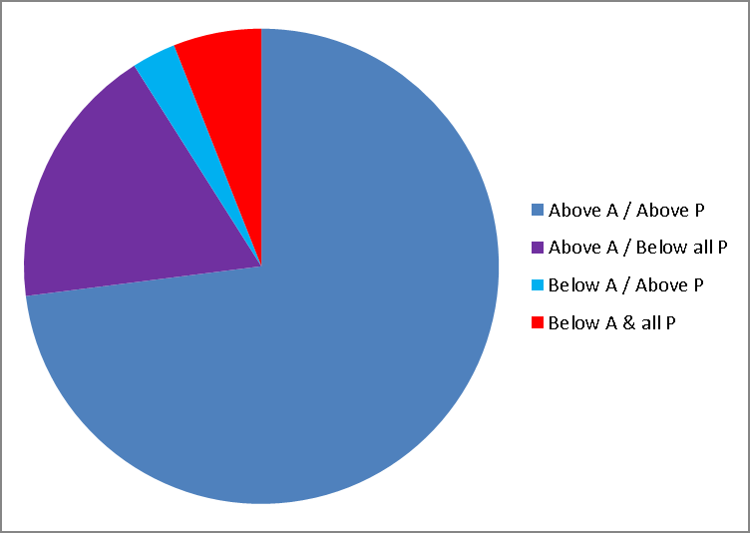
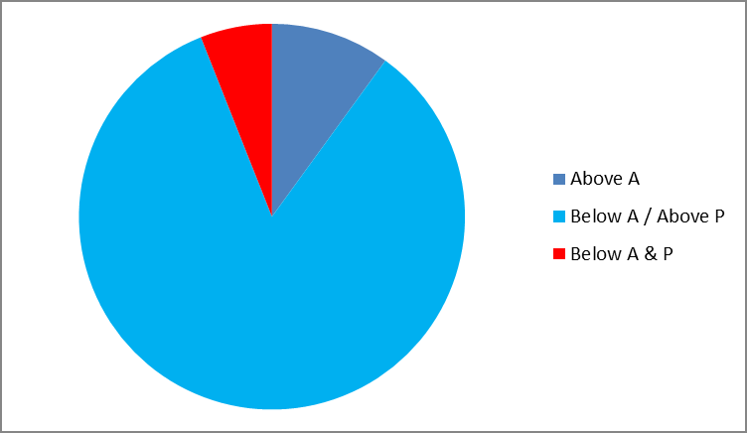
Attainment and Accountability
2014 2016??

Slide 13
Key implications
Pupil progress in R, W & M rather than attainment is now the focus
Our school’s pupil progress tracking system now takes account of new, national ‘performance descriptors’
Progress ‘data’ derived from statutory assessment will go through changing forms until 2023
‘Sufficient progress’ will not be defined in advance so schools need to be able to justify how they have used assessment to improve learning

Slide 14
Actions
We have made sure that our school curriculum takes account National Curriculum requirements
We have revisited basic principles of assessment – recognising learning in order to provide good feedback, improve teaching and focus resources
We are reviewing how to report to parents so they’re clear about how pupils have improved and their next steps
We will avoid the use of numbers / labels with pupils and parents and confine them to internal discussions and analysis of progress towards year groups expectations

Slide 15
Actions (continued)
We have reviewed how to identify and track pupils who need additional support and the effectiveness of that support (including use of pupil premium)
We are working with other schools, especially Bispham, to develop common approaches for English and Mathematics – diversity doesn’t help teachers or parents develop a shared understanding of what’s expected

Slide 16
A good assessment system should tell us two things:
Breadth
Depth
The level of fluency, ability to apply and level of understanding
How much learning do we see?

Slide 17
Beginning, Achieving and Deep
Depth of learning | Cognitive challenge | Predominant teaching style | Type of success criteria | Nature of progress | support | quantity | Typically, pupils will
BEGINNING | Low level cognitive demand, involves following instructions | Modelling Explaining | Steps to success | Acquiring Refining | High | Some | name, describe, follow instructions or methods, complete tasks, recall information, ask basic questions, use, match, report, measure, list, illustrate, label, recognise, tell, repeat, arrange, define, memorise
ACHIEVING | Higher level of cognitive demand. Involves mental processing beyond recall. Requires some degree of decision making. | Reminding Guiding | Remember to include | Applying Practising | Medium | Most | apply skills to solve problems, explain methods, classify, infer, categorise, identify patterns, organise, modify, predict, interpret, summarise, make observations, estimate, compare
DEEP | Cognitive demands are complex and abstract. Involves problems with multi steps or more than one possible answer. Requires justification of answers | Coaching Probing Deep Questioning | Child generated | Deepening Extending | Low | All | solve non routine problems, appraise, explain concepts, hypothesise, investigate, cite evidence, design, create, prove

Slide 18
First:
Focus on Year Group Expectations
Year Group Expectations
For each subject the National Curriculum clearly outlines what has to be met in order for a learner to be ‘At the National Standard’ the expected standard for their year group.
For example, on the next page is the set of statements that would be expected to be met for a pupil to be deemed to be at the Year 1 National Standard in Mathematics (Number)

Slide 19
Focus on Expectations: The first job is to get to know the expectations for each age group and for each subject: ie, reading, writing, spoken language, mathematics and science.
At (ACHIEVING)the National Standard
Example:
Year 1 Number
Working towards (BEGINNING) the National Standard
Exceeding (DEEP)
The National Standard
Year 1 Expectations: Number
Count reliably to 100 | Mathematics (Number) Meeting Expectations for Year 1
Count on and back in 1s, 2s, 5s, and 10s from any given number to 100
Write all numbers in words to 20
Say the number that is one more or one less than a number to 100
Recall all pairs of addition and subtraction number bonds to 20
Add and subtract 1-digit and 2-digit numbers to 20, including zero
Know the signs (+); (-) and (=)
Solve a missing number problem, such as: 5 = 8 - x
Solve a one-step problem involving an addition and subtraction, using concrete objects, pictorial representations and arrays
Solve a one-step problem involving a multiplication and division, using concrete objects, pictorial representations and arrays
If these are met then consider ‘exceeding’ statements
If these are not met then they are ‘working towards the National Standard’

Slide 20
The 6-point scale
6 Point System
Assessed position | Working towards (BEGINNING) the National Standard |  | At (ACHIEVING) the National Standard |  | Exceeding (DEEP) the National Standard
Points allocation | 1 | 2 | 3 | 4 | 5 | 6
Working towards
the National Standard
(BEGINNING)
At the
National Standard
(Achieving)
Mastery of the
National Standard
(Deep)

Slide 21
The 6-point system
A pupil will be deemed to be working towards the National Standard (BEGINNING) if they do not meet all of the statements outlined for that year group
A pupil will be deemed to be at the National Standard (ACHIEVING) only if they can satisfy their teacher that they meet all the expectations for their age
A pupil will be deemed to be mastering the National Standard (DEEP) when in addition to the statements set out for being at the National Standard they meet one or more of two sets of further expectations
Pupils will be deemed to be mastering the National Standards if, in addition to what is outlined as Point 3 and 4, they show evidence of:
Being able to use the year group’s expectation within context
Being able to consistently apply the year group objectives in a range of situations.
Accessing some of the following year group’s objectives
A set of mastering the National Standard statements are set out for you to feel secure about your judgements.
If a pupil is meeting the ‘mastering statements, even though they make the occasional mistake, they will be deemed to be at Point 5.
If they are very confident and rarely make a mistake in relation to the ‘mastering’ statements then they will be judged at Point 6
If they meet more than 50% of the statements but not all then they will be described as:
Working towards the National Standard – Point 2
If they do not meet 50% of the statements then they will be described as:
Working towards the National Standard or Below the National Standard – Point 1
There is therefore no requirement to write a set of working towards the National Standard statements
At the National Standard – Point 3
It is accepted that a pupil might make the occasional error if they are at this stage. Pupils are generally confident in dealing with the objectives outlined
At the National Standard - Point 4
At this stage, not only is the pupil confident at meeting the statements but works at a rapid rate. However, they are not yet meeting all the statements for mastery, but they meeting at least 50% of the mastery statements.

Slide 22
Working towards the National Standard
(BEGINNING)
Point 1
Point 2
Working towards the National Standard
This is the stage that most children will be in for most of the year, i.e. they are demonstrating typical attainment for their age – they are working towards attaining the end of year expectations (the National Standard).

Slide 23
At the National Standard
(ACHIEVING)
-
Point 3
Point 4
At the National Standard
This is the ‘tick in the box’, summative, attainment measure when children have MET the end of year expectations.
What constitutes met? – Meeting all the expectations or best fit in line with key stage descriptors
i.e. ‘Best fit’ - Pupils are generally confident in dealing with the objectives outlined

Slide 24
Mastery of the National Standard
(DEEP)
Point 5
Point 6
Mastery of the National Standard
This is the stage that describes children that have exceeded the ‘At the National Standard’ statements, i.e. they are working beyond age typical expectations. This is the stage where children will be evidencing breadth, depth and application.

Slide 25
Below
the National Standard
Below the National Standard
This is the stage that describes children working below the age typical expectations. This would be used for children with cognitive / developmental delay. This stage should only be used where children are not able to access age typical expectations working towards the National Standard). Children in this stage should have a ‘sub descriptor’ which shows where they are actually working, e.g. P scales

Slide 26
What information will I receive about how my child is doing?
We will continue to tell parents and carers about children’s attainment as we do now, in meetings, reports, etc.
For children in Y1 and Y2 this will now involve attainment judged on ‘expectations’ (not coverage and instead of levels).
Individual targets are still important and will continue to be discussed at parents’ evenings.
When the children in Y2 take their SATs in May 2016, they will be tested on the new curriculum. This will be reported differently than before (e.g. not with a ‘level’).

Slide 27
What are the important things to remember?
The new curriculum is harder, age related expectations are more stretching so children may remain at a ‘BEGINNING’ depth of learning for a time in each year group.
Information about your child’s progress will be shared through termly reports and during parents evenings.

