Slide 2
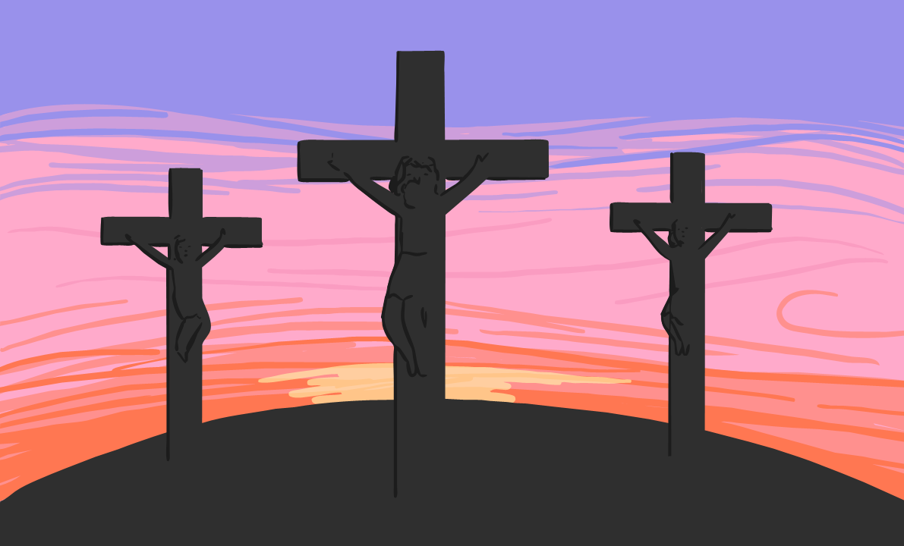
Why Do People Celebrate Easter?
It is a Christian festival.
It is the oldest and most important Christian Festival.
To celebrate the death and coming to life again of Jesus Christ.
For Christians, the dawn of Easter Sunday with its message of new life is the high point of the Christian year.

Slide 3
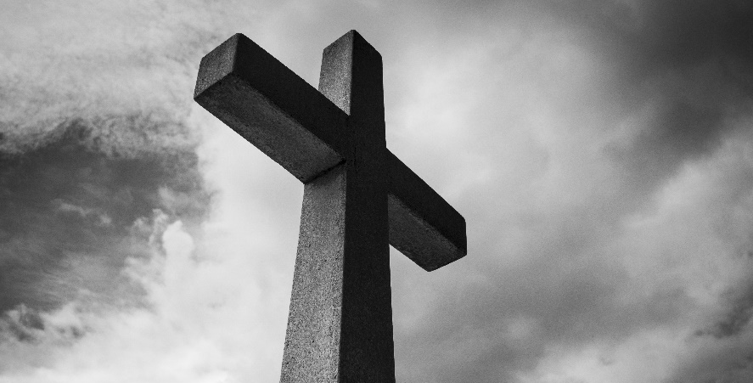
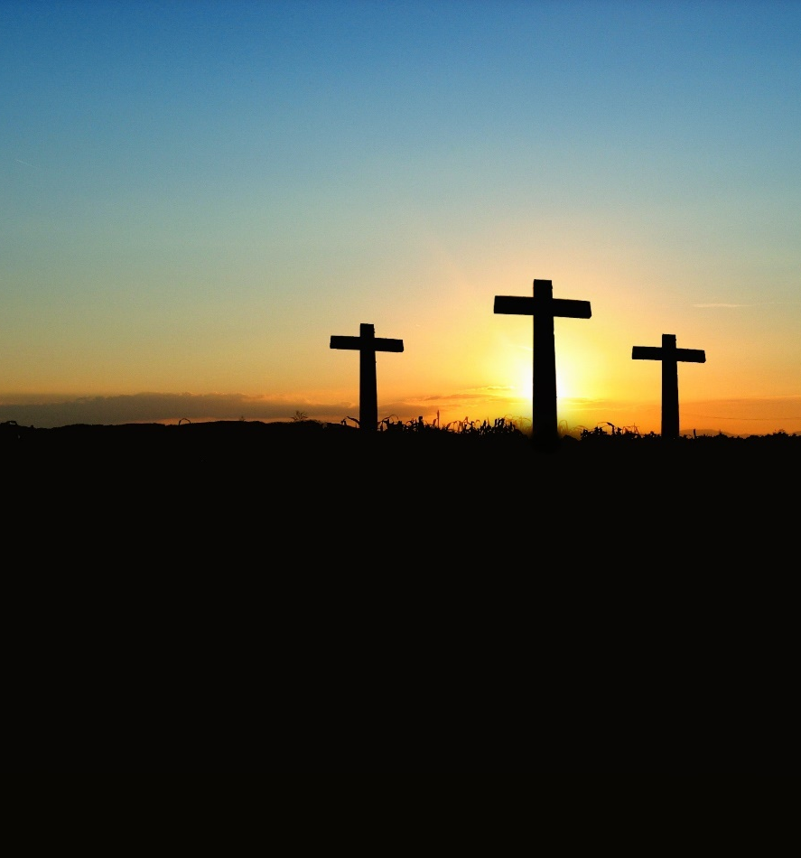
Who Celebrates Easter?
Easter is celebrated by Christians all over the world.

Slide 4
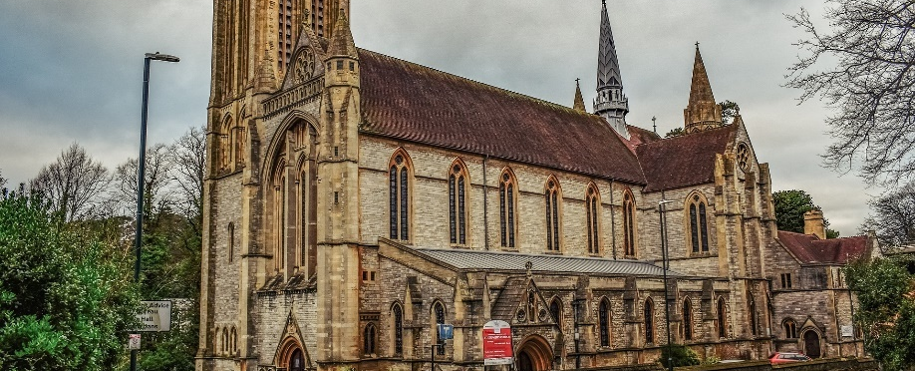
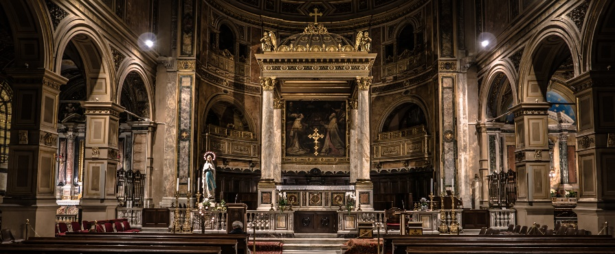
Where Do People Celebrate Easter?
In churches all over the world.
Services sometimes start at midnight of Easter Eve. Candles are used in churches all over the world to start the midnight celebrations.
In Greece, fireworks are sometimes used to start the service.
Churches are often filled with flowers on Easter Day - these represent new life.
Christians also celebrate Easter in their own homes.

Slide 5
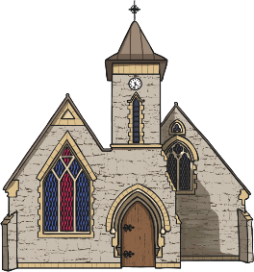
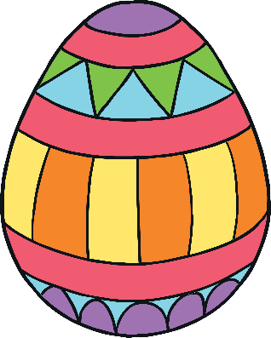
How Do People Celebrate Easter?
By going to church for a special Easter service.
By giving Easter cards.
By eating a special meal with friends and family.
By giving chocolate eggs, going on Easter egg hunts, decorating an egg. Eggs are used as a symbol of new life.
By eating hot cross buns.

